Slide 1

Transportation problem using linear programming
Presented by - Hari Om Jee

Slide 2
WHAT IS TRANSPORTATION PROBLEM ?
•The transportation problem is a special type of linear programming problem where the objective is to minimize the cost of distributing a product from a number of sources or origins to a number of destinations.
• Because of its special structure, the usual simplex method is not suitable for solving transportation problems. These problems require a special method of solution.

Slide 3
AIM OF TRANSPORTATION PROBLEM?
To find out the optimum transportation schedule keeping in mind cost of transportation to be minimized.
• The origin of a transportation problem is the location from which shipments are dispatched.
• The destination of a transportation problem is the location to which shipments are transported.
• The unit transportation cost is the cost of transporting one unit of the consignment from an origin to a destination

Slide 4
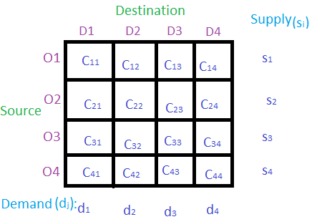
OBJECTIVES OF TRANSPORTATION PROBLEM?
Determination of a transportation plan of a single commodity.
From a number of sources.
To a number of destinations.
Such that total cost of transportation id minimized.
Basic Structure of transportation Problem

Slide 5
TWO TYPES OF TRANSPORTATION PROBLEM?
Balanced transportation problem:-
Where the total supply equally total demand.
Unbalanced transportation problem:-
where the total supply is not equally total demand.

Slide 6
Methods of Finding Initial Basic Feasible Solution ?
NORTH-WEST CORNER RULE(NWCR)
LEAST COST METHOD(LCM)
VOGLE APPROXIMATION METHOD(VAM)

Slide 7
NORTH-WEST CORNER RULE(NWCR)
The simplest of the procedures used to generate an initial feasible solution is NWCM. It begins with the North West or upper left corner cell of transportation table.
•It is most systematic and easiest method for obtaining Initial Feasible Basic Solution.

Slide 8
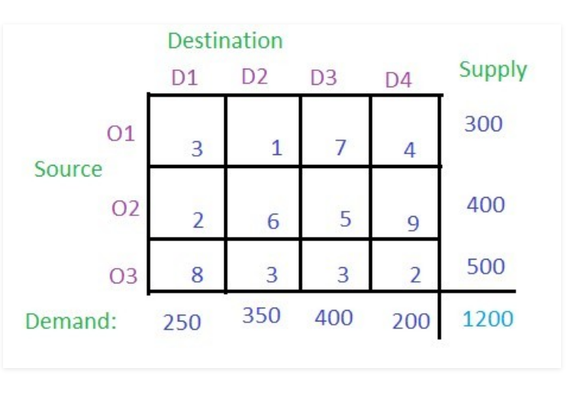
problem-
Solution-
Step1- According to NWCR method, (O1, D1) has to be the starting point. That is the north-west corner of the table. Each and every value in the cell is considered as the cost per transportation. Compare the demand for column D1 and supply from the source O1 and allocate the minimum of two to the cell (O1, D1).

Slide 9
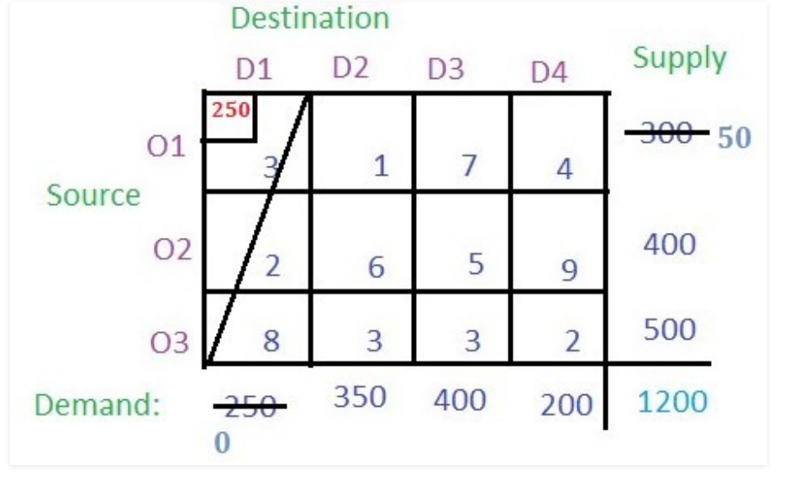
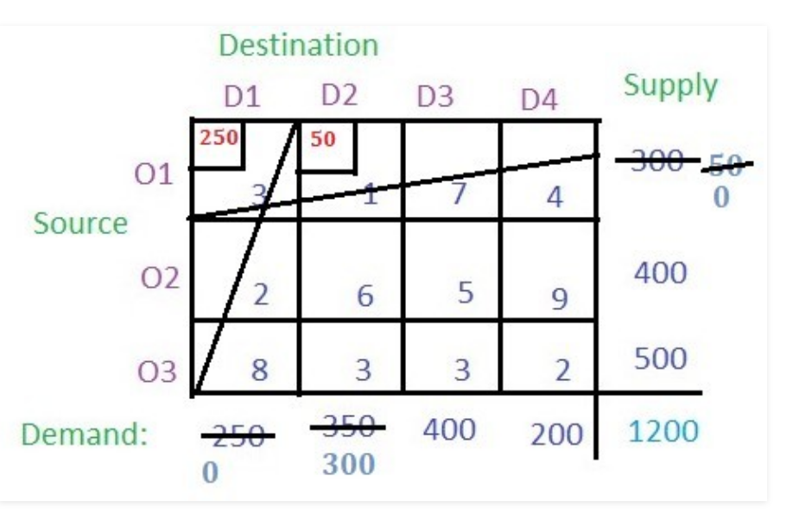
Step2- The demand for Column D1 is completed so the entire column D1 will be canceled. The supply from the source O1 remains 300 – 250 = 50.
Step3- Now from the remaining table i.e. excluding column D1, check the north-west corner i.e. (O1, D2) and allocate the minimum among the supply for the respective column and the rows. The supply from O1 is 50 which is less than the demand for D2 (i.e. 350), so allocate 50 to the cell (O1, D2). Since the supply from row O1 is completed cancel the row O1. The demand for column D2 remain 350 – 50 = 300.

Slide 10
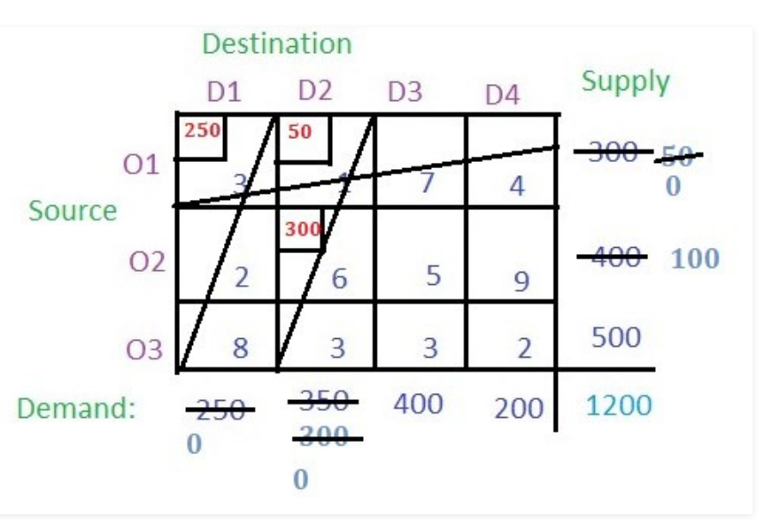
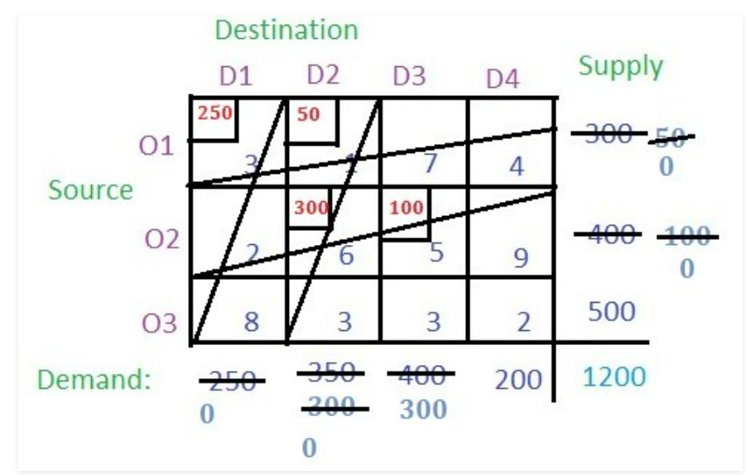
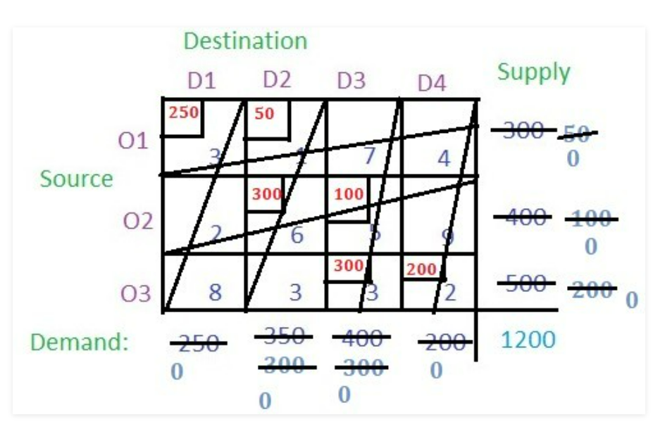
Step4- Proceeding in the same way, the final values of the cells will be:

Slide 11
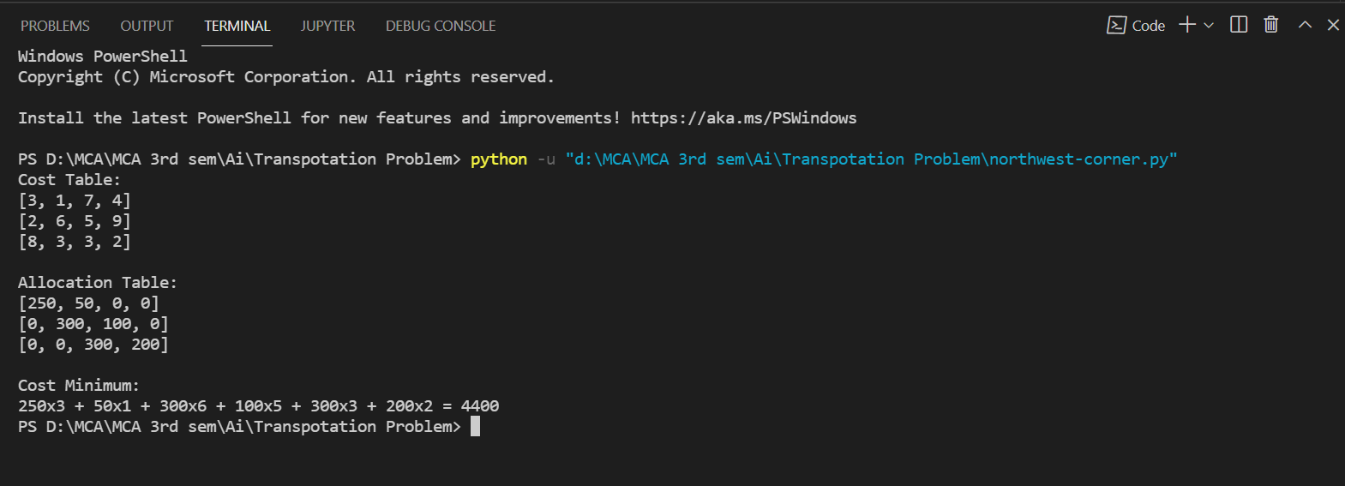
Step5- Now just multiply the allocated value with the respective cell value (i.e. the cost) and add all of them to get the basic solution i.e.
(250 * 3) + (50 * 1) + (300 * 6) + (100 * 5) + (300 * 3) + (200 * 2) = 4400

Slide 12
LEAST COST METHOD(LCM)
The allocation according to this method is very useful as it takes into consideration the lowest cost and therefore, reduce the computation as well as the amount of time necessary to arrive at the optimal solution.

Slide 13
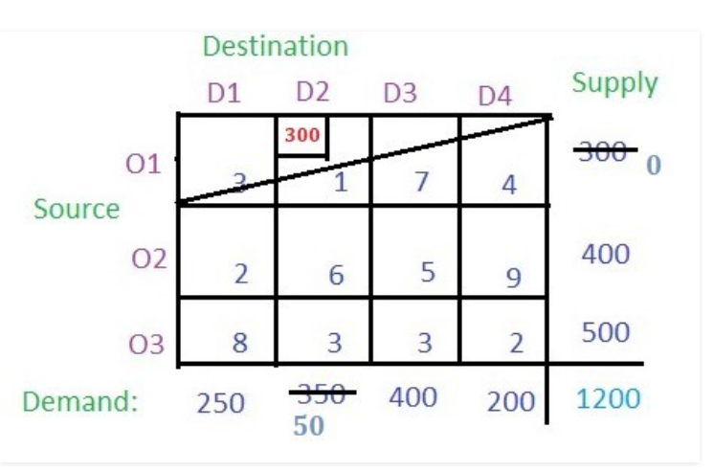
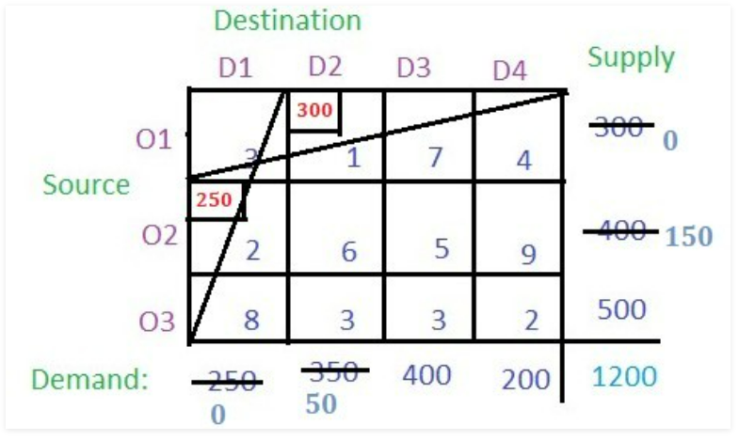
Solution-
Step1- According to the Least Cost Cell method, the least cost among all the cells in the table has to be found which is 1 (i.e. cell(O1, D2)). Now check the supply from the row O1 and demand for column D2 and allocate the smaller value to the cell. The smaller value is 300 so allocate this to the cell. The supply from O1 is completed so cancel this row and the remaining demand for the column D2 is 350 – 300 = 50.
Step2- Now find the cell with the least cost among the remaining cells. There are two cells with the least cost i.e. (O2, D1) and (O3, D4) with cost 2. Lets select (O2, D1). Now find the demand and supply for the respective cell and allocate the minimum among them to the cell and cancel the row or column whose supply or demand becomes 0 after allocation.

Slide 14
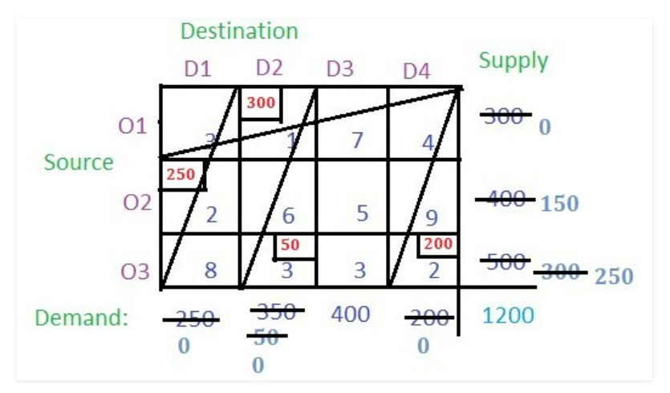
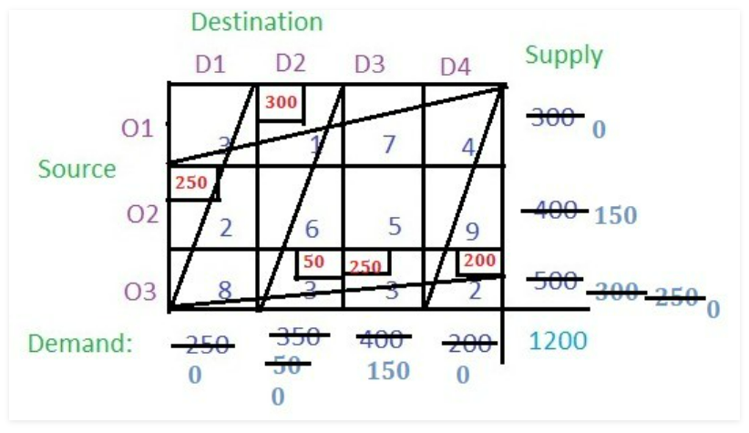
Step3- Now the cell with the least cost is (O3, D4) with cost 2. Allocate this cell with 200 as the demand is smaller than the supply. So the column gets cancelled.
Step4- There are two cells among the unallocated cells that have the least cost. Choose any at random say (O3, D2). Allocate this cell with a minimum among the supply from the respective row and the demand of the respective column. Cancel the row or column with zero value.
Step5- Now the cell with the least cost is (O3, D3). Allocate the minimum of supply and demand and cancel the row or column with zero value.

Slide 15
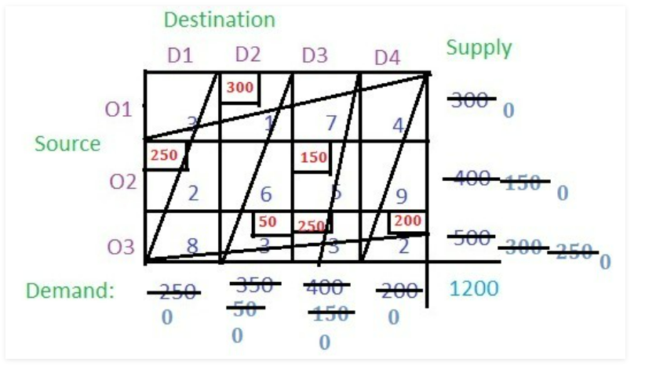
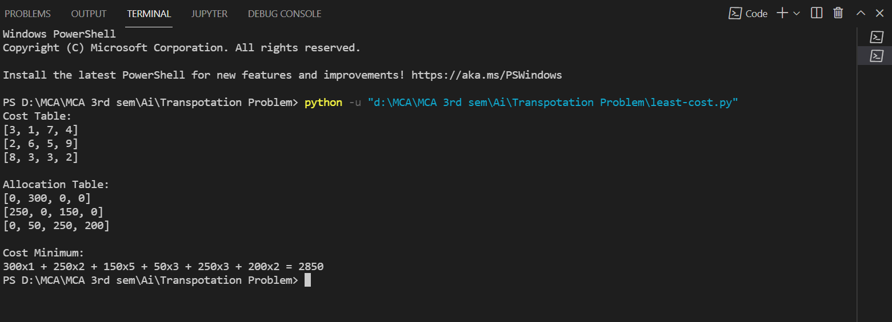
Step6- The only remaining cell is (O2, D3) with cost 5 and its supply is 150 and demand is 150 i.e. demand and supply both are equal. Allocate it to this cell.
Step7- Now just multiply the cost of the cell with their respective allocated values and add all of them to get the basic solution i.e.
(300 * 1) + (250 * 2) + (150 * 5) + (50 * 3) + (250 * 3) + (200 * 2) = 2850

Slide 16
VOGLE APPROXIMATION METHOD(VAM)
This method is preferred over the others methods because the initial feasible solution obtained is either optimal or very close to the optimal solution.
This is the best Method . It gives the optional solutions.

Slide 17
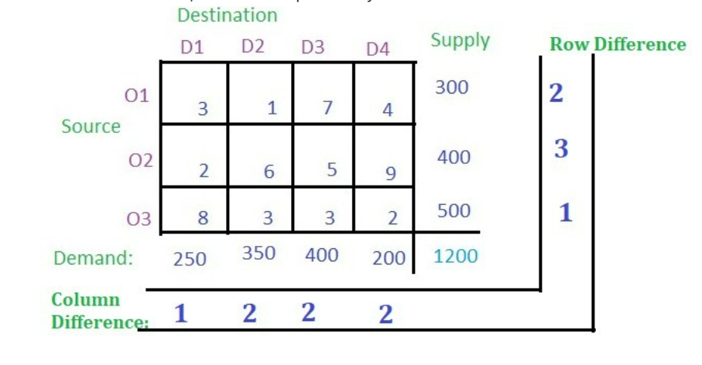
Solutions-
Step1- For each row find the least value and then the second least value and take the absolute difference of these two least values and write it in the corresponding row difference as shown in the image below. In row O1, 1 is the least value and 3 is the second least value and their absolute difference is 2. Similarly, for row O2 and O3, the absolute differences are 3 and 1 respectively.

Slide 18
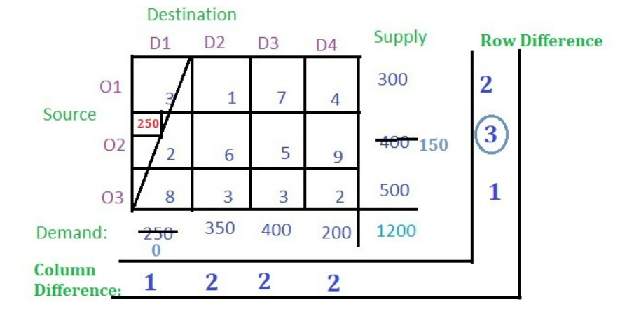
Step2- For each column find the least value and then the second least value and take the absolute difference of these two least values then write it in the corresponding column difference as shown in the figure. In column D1, 2 is the least value and 3 is the second least value and their absolute difference is 1. Similarly, for column D2, D3 and D3, the absolute differences are 2, 2 and 2 respectively.
Step3- These value of row difference and column difference are also called as penalty. Now select the maximum penalty. The maximum penalty is 3 i.e. row O2. Now find the cell with the least cost in row O2 and allocate the minimum among the supply of the respective row and the demand of the respective column. Demand is smaller than the supply so allocate the column’s demand i.e. 250 to the cell. Then cancel the column D1.

Slide 19
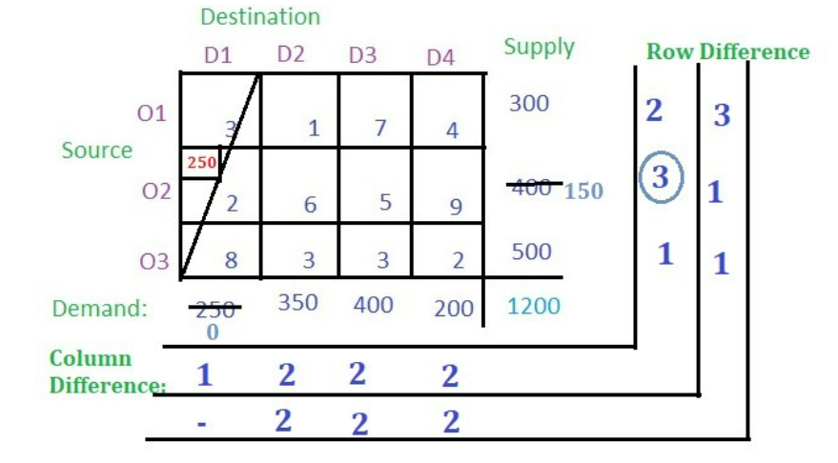
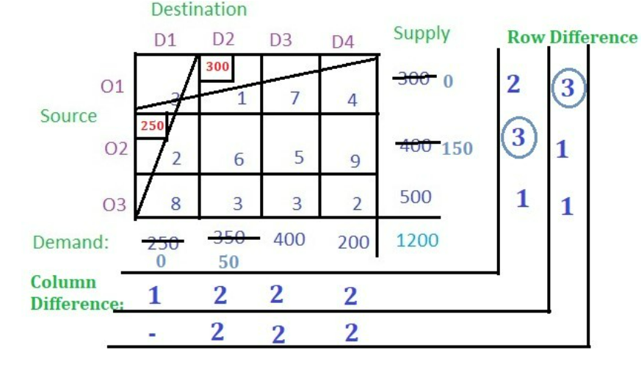
Step4- From the remaining cells, find out the row difference and column difference.
Step5- Again select the maximum penalty which is 3 corresponding to row O1. The least-cost cell in row O1 is (O1, D2) with cost 1. Allocate the minimum among supply and demand from the respective row and column to the cell. Cancel the row or column with zero value.

Slide 20
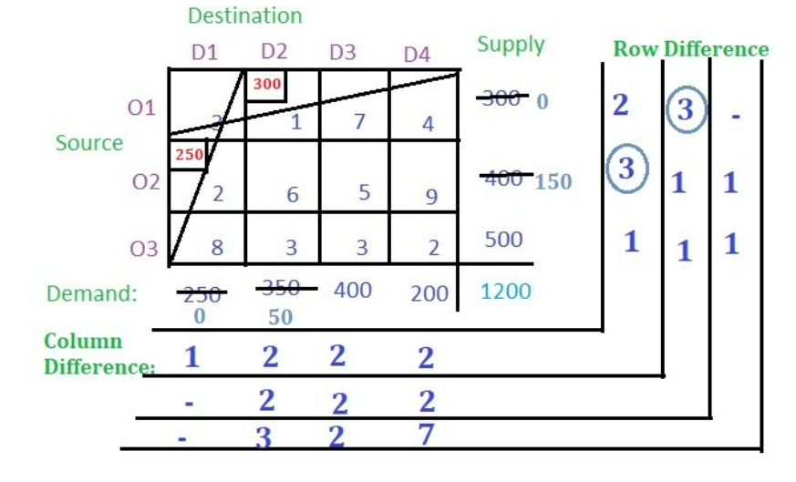
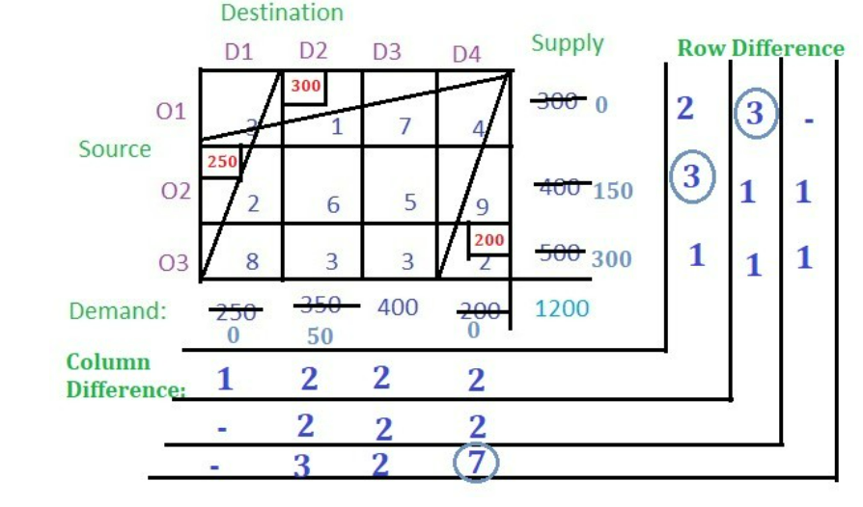
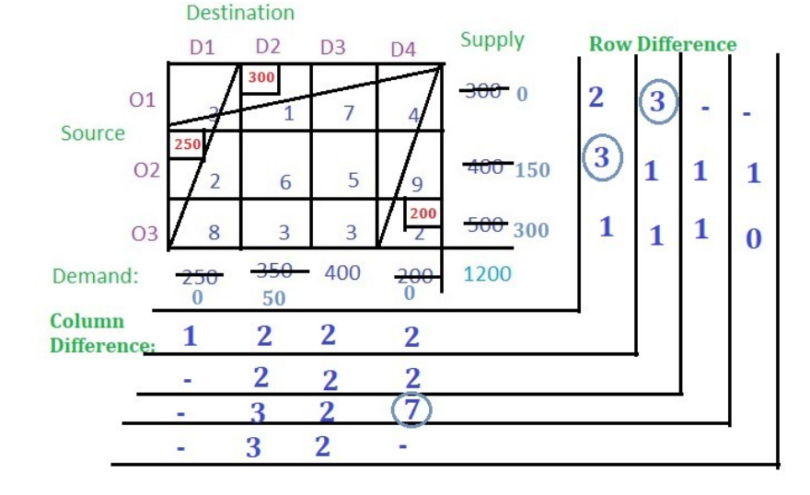
Step5- Now find the row difference and column difference from the remaining cells.
Step6- Like this we processed further.

Slide 21
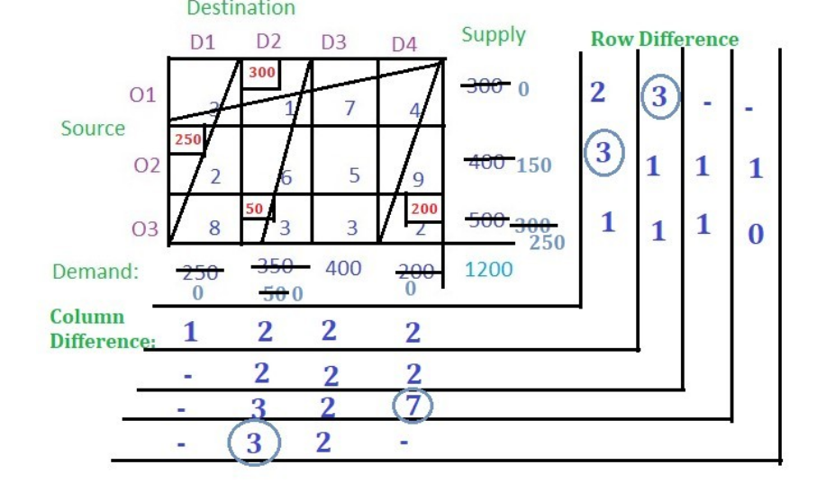
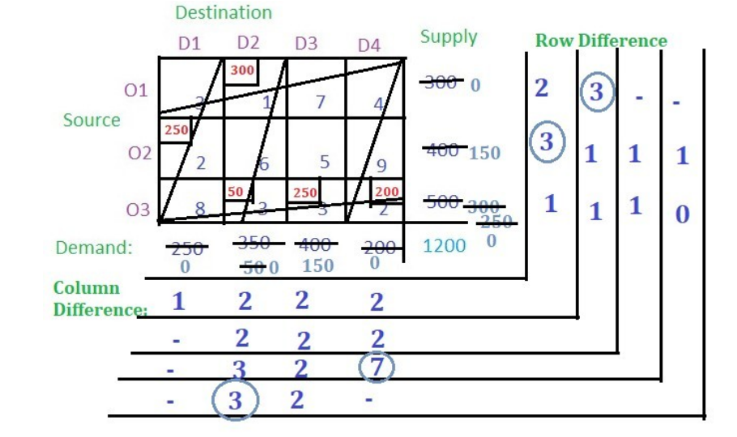
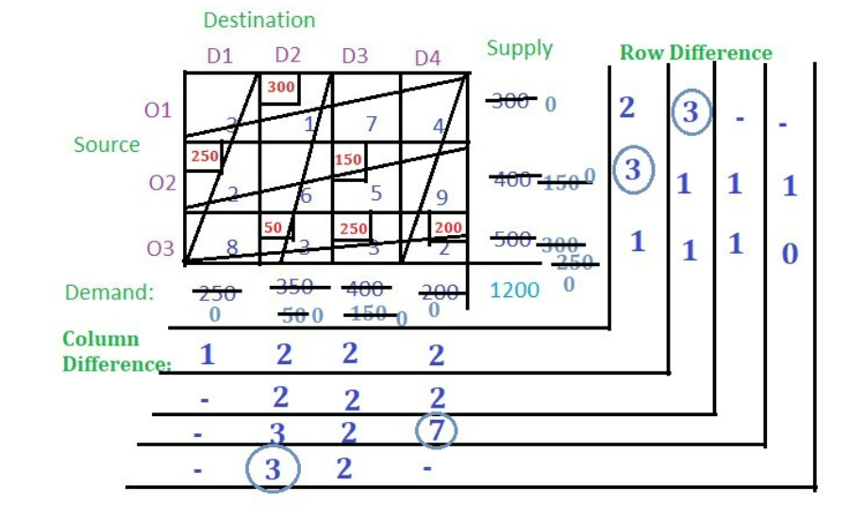
.Now there is only one cell so allocate the remaining demand or supply to the cell

Slide 22
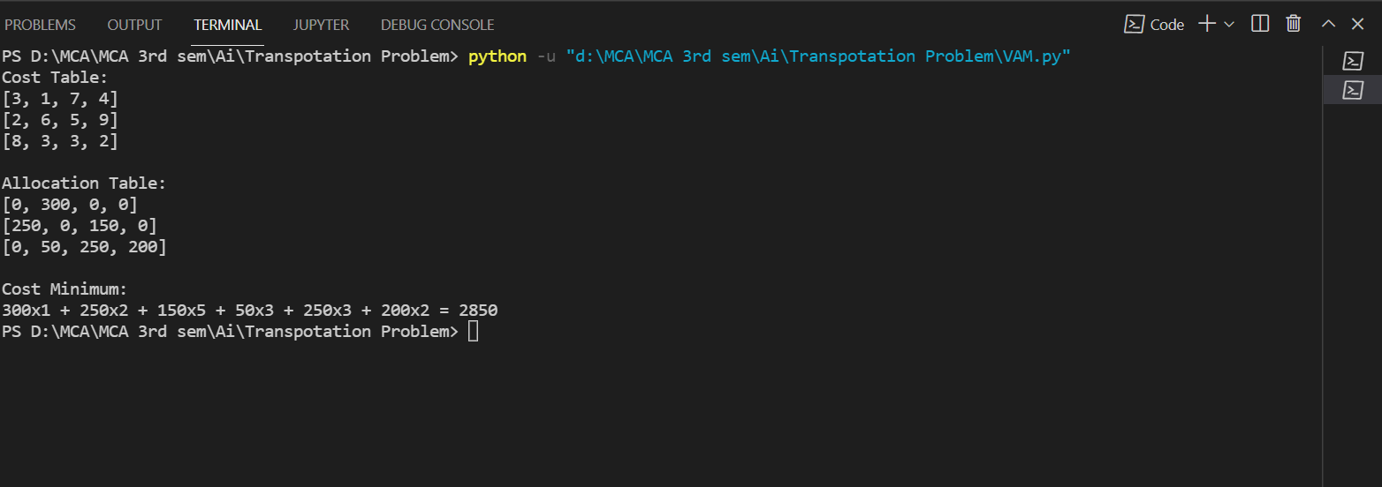
.No balance remains. So multiply the allocated value of the cells with their corresponding cell cost and add all to get the final cost i.e.
(300 * 1) + (250 * 2) + (50 * 3) + (250 * 3) + (200 * 2) + (150 * 5) = 2850

Slide 23
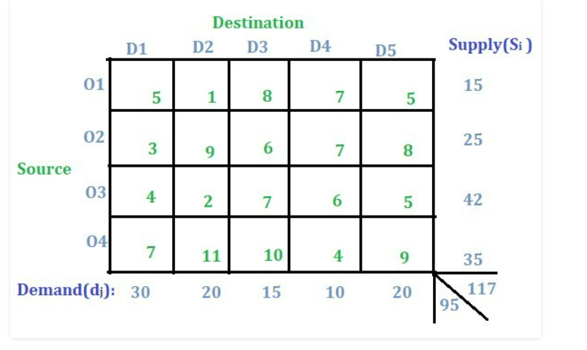
Unbalanced -
Problem-
Solution-
In this type of problem, the concept of a dummy row or a dummy column will be used.
1. If supply is more than the demand so a dummy demand column will be added .
2. If demand is more than the supply so a dummy supply row will be added
For added value = Total supply – Total demand.

Slide 24


